Slide 1
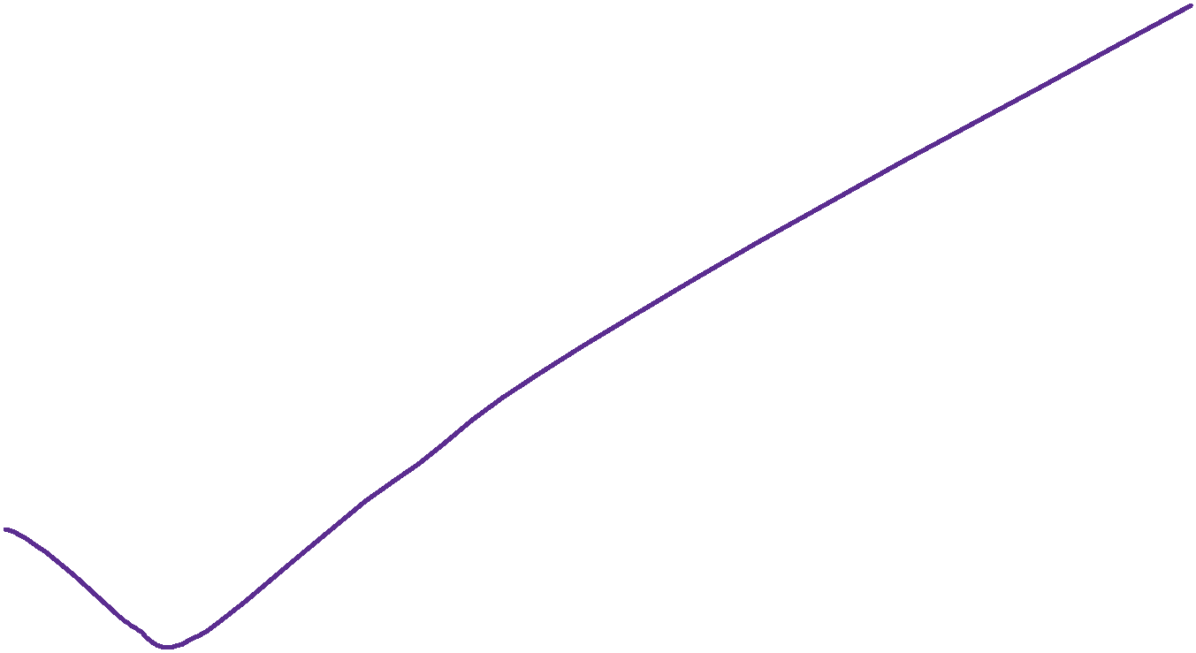
COD Ch. 4 Arithmetic for Computers

Slide 2



Arithmetic
Where we've been:
performance
abstractions
instruction set architecture
assembly language and machine language
What's up ahead:
implementing the architecture
operation
a
32
ALU
result
32
b
32
Notes:
‹#›

Slide 3
MIPS – 2’s complement
32 bit signed numbers:
0000 0000 0000 0000 0000 0000 0000 0000_{two} = 0_{ten} 0000 0000 0000 0000 0000 0000 0000 0001_{two} = + 1_{ten} 0000 0000 0000 0000 0000 0000 0000 0010_{two} = + 2_{ten} ... 0111 1111 1111 1111 1111 1111 1111 1110_{two} = + 2,147,483,646_{ten} 0111 1111 1111 1111 1111 1111 1111 1111_{two} = + 2,147,483,647_{ten} 1000 0000 0000 0000 0000 0000 0000 0000_{two} = – 2,147,483,648_{ten} 1000 0000 0000 0000 0000 0000 0000 0001_{two} = – 2,147,483,647_{ten} 1000 0000 0000 0000 0000 0000 0000 0010_{two} = – 2,147,483,646_{ten} ... 1111 1111 1111 1111 1111 1111 1111 1101_{two} = – 3_{ten} 1111 1111 1111 1111 1111 1111 1111 1110_{two} = – 2_{ten} 1111 1111 1111 1111 1111 1111 1111 1111_{two} = – 1_{ten}
maxint
minint
Negative integers are exactly those that have leftmost bit 1
Notes:
‹#›

Slide 4

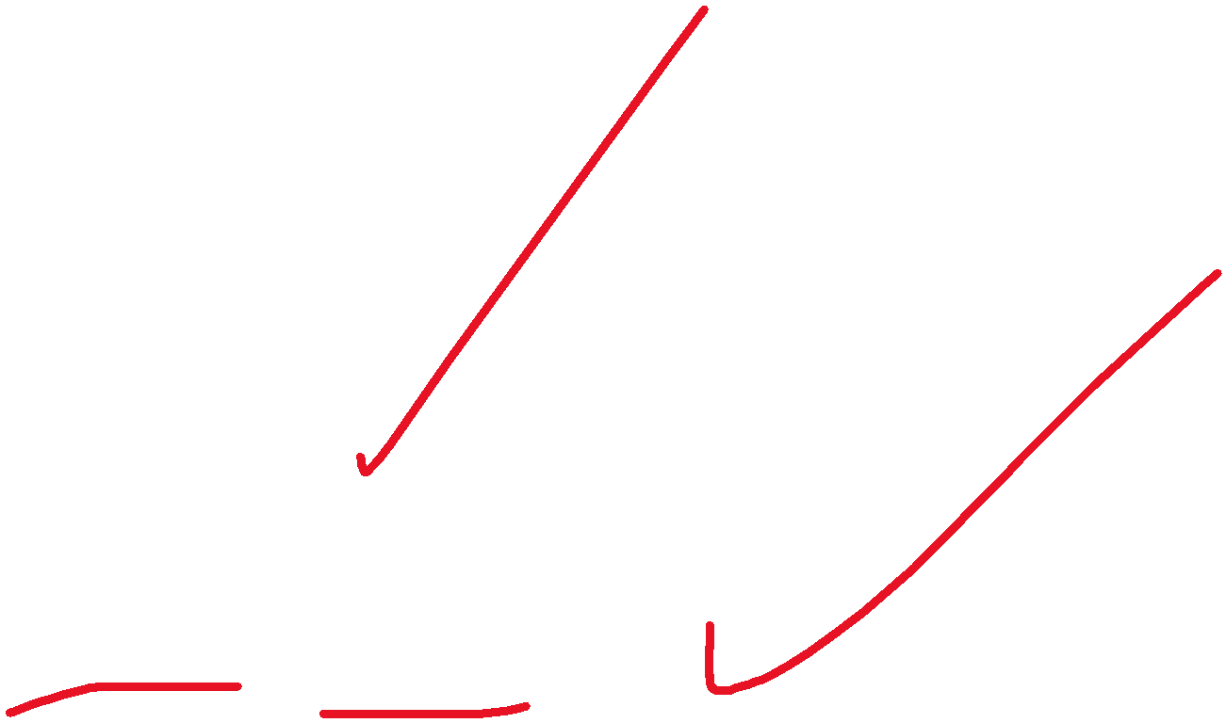



Two's Complement Operations
Negation Shortcut: To negate any two's complement integer invert all bits and add 1
note that negate and invert are different operations!
why does this work? Remember we don’t know how to add in 2’s complement yet! Later…!
Sign Extension Shortcut: To convert an n-bit integer into an integer with more than n bits – i.e., to make a narrow integer fill a wider word – replicate the most significant bit (msb) of the original number to fill the new bits to its left
Example: 4-bit 8-bit
0010 = 0000 0010 1010 = 1111 1010
why is this correct? Prove!
Notes:
‹#›

Slide 5
Two’s Complement Addition
Perform add just as in junior school (carry/borrow 1s)
Examples (4-bits):
0101 0110 1011 1001 1111
0001 0101 0111 1010 1110
Do these sums now!! Remember all registers are 4-bit including result register!
So you have to throw away the carry-out from the msb!!
Have to beware of overflow : if the fixed number of bits (4, 8, 16, 32, etc.) in a register cannot represent the result of the operation
terminology alert: overflow does not mean there was a carry-out from the msb that we lost (though it sounds like that!) – it means simply that the result in the fixed-sized register is incorrect
as can be seen from the above examples there are cases when the result is correct even after losing the carry-out from the msb
Notes:
‹#›

Slide 6
Two’s Complement Addition: Verifying Carry/Borrow method
Two (n+1)-bit integers: X = x_{n}X’, Y = y_{n}Y’
x_{n} = 0, y_{n} = 0 ok not ok(overflow!)
x_{n} = 1, y_{n} = 0 ok ok
x_{n} = 0, y_{n} = 1 ok ok
x_{n} = 1, y_{n} = 1 not ok(overflow!) ok
Prove the cases above!
Prove if there is one more bit (total n+2 then) available for the result then there is no problem with overflow in add!
Carry/borrow
add X + Y
0 ≤ X’ + Y’ < 2^{n}
(no CarryIn to last bit)
2^{n} ≤ X’ + Y’ < 2^{n+1} – 1
(CarryIn to last bit)

Slide 7
Two's Complement Operations
Now verify the negation shortcut!
consider X + (X +1) = (X + X) + 1:
associative law – but what if there is overflow in one of the adds on either side, i.e., the result is wrong…!
think minint !
Examples:
–0101 = 1010 + 1 = 1011
–1100 = 0011 + 1 = 0100
–1000 = 0111 + 1 = 1000

Slide 8
Detecting Overflow
No overflow when adding a positive and a negative number
No overflow when subtracting numbers with the same sign
Overflow occurs when the result has “wrong” sign (verify!):
Operation Operand A Operand B Result
Indicating Overflow
A + B ≥ 0 ≥ 0 < 0
A + B < 0 < 0 ≥ 0
A – B ≥ 0 < 0 < 0
A – B < 0 ≥ 0 ≥ 0
Consider the operations A + B, and A – B
can overflow occur if B is 0 ?
can overflow occur if A is 0 ?
Notes:
‹#›

Slide 9
Effects of Overflow
If an exception (interrupt) occurs
control jumps to predefined address for exception
interrupted address is saved for possible resumption
Details based on software system/language
SPIM: see the EPC and Cause registers
Don't always want to cause exception on overflow
add, addi, sub cause exceptions on overflow
addu, addiu, subu do not cause exceptions on overflow
Notes:
‹#›

Slide 10
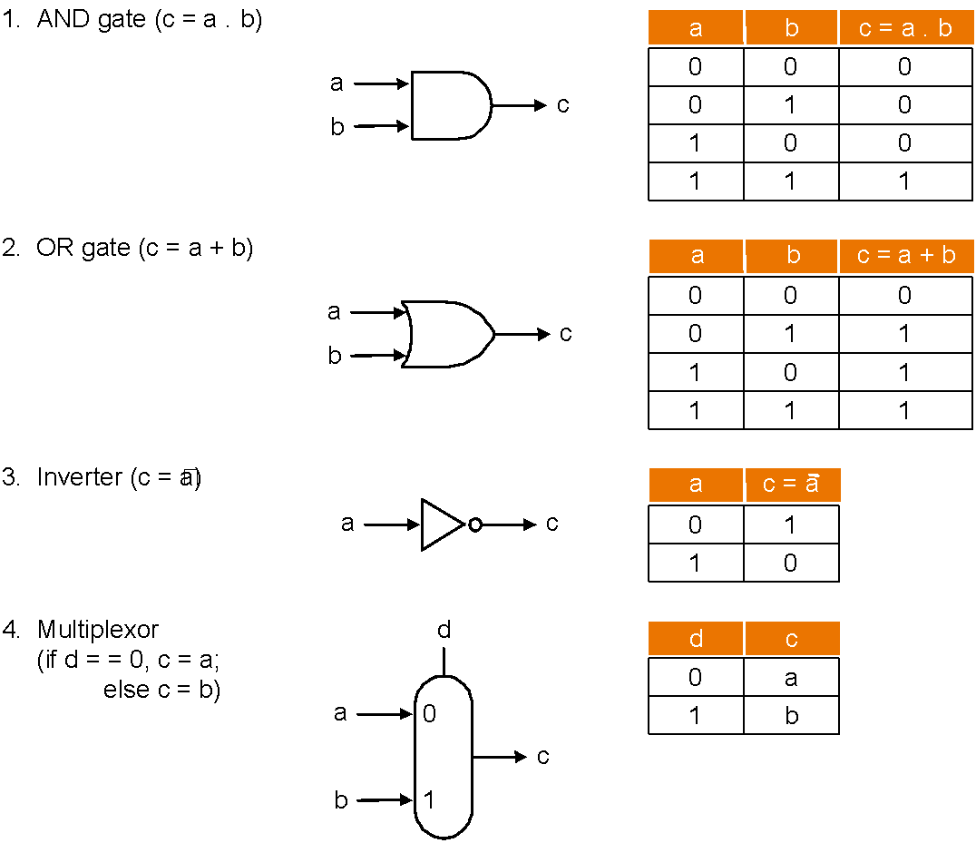
Review: Basic Hardware

Slide 11
Review: Boolean Algebra & Gates
Problem: Consider logic functions with three inputs: A, B, C.
output D is true if at least one input is true
output E is true if exactly two inputs are true
output F is true only if all three inputs are true
Show the truth table for these three functions
Show the Boolean equations for these three functions
Show an implementation consisting of inverters, AND, and OR gates.
Notes:
‹#›

Slide 12
A Simple Multi-Function Logic Unit
To warm up let's build a logic unit to support the and and or instructions for MIPS (32-bit registers)
we'll just build a 1-bit unit and use 32 of them
Possible implementation using a multiplexor :
operation
selector
a
output
b
Notes:
‹#›

Slide 13
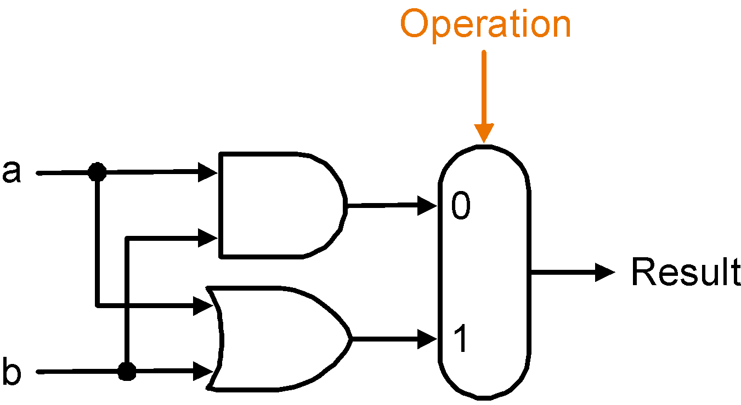
Implementation with a Multiplexor
Selects one of the inputs to be the output
based on a control input
Lets build our ALU using a MUX (multiplexor):
.
.
.
32 units
Notes:
‹#›

Slide 14
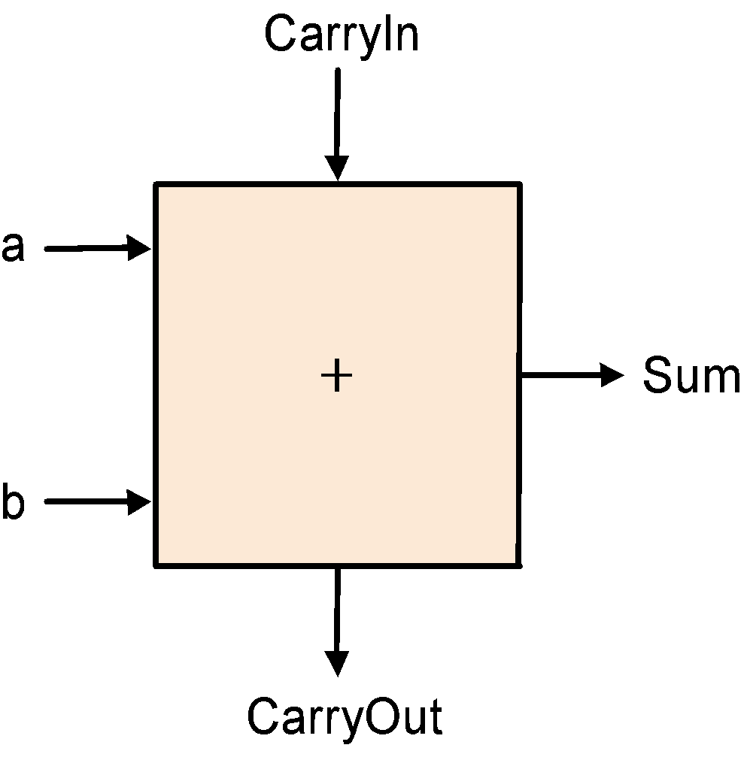
Implementations
Not easy to decide the best way to implement something
do not want too many inputs to a single gate
do not want to have to go through too many gates (= levels)
for our purposes, ease of comprehension is important
Let's look at a 1-bit ALU for addition:
How could we build a 1-bit ALU for add, and, and or?
How could we build a 32-bit ALU?
c_{out} = a.b + a.c_{in} + b.c_{in}
sum = a.b.c_{in} + a.b.c_{in} +
a.b.c_{in} + a.b.c_{in}
= a ⊕ b ⊕ c_{in}
exclusive or (xor)
Notes:
‹#›

Slide 15
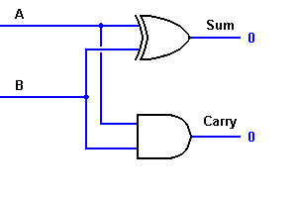
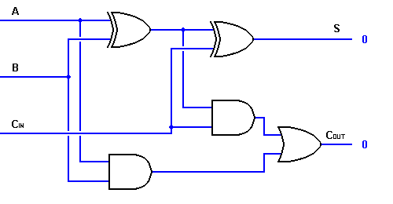
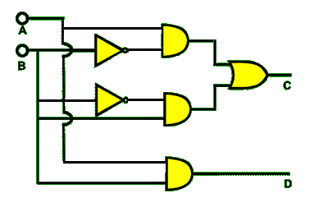
1-bit Adder Logic
xor
Half-adder with one xor gate
Full-adder from 2 half-adders and
an or gate
Half-adder with the xor gate replaced
by primitive gates using the equation
A⊕B = A.B +A.B

Slide 16
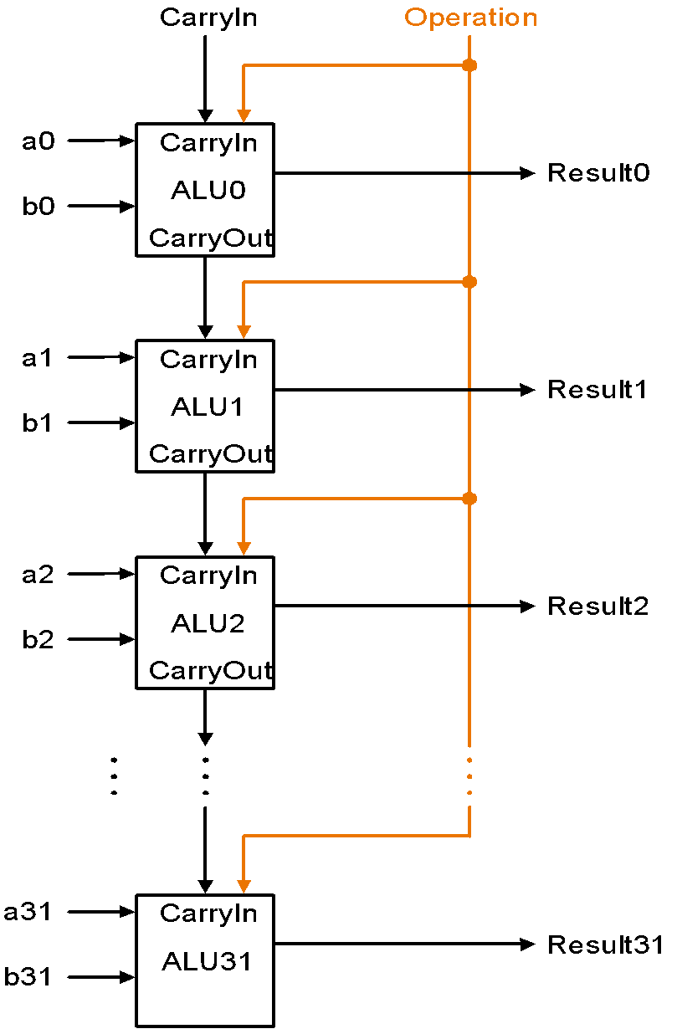
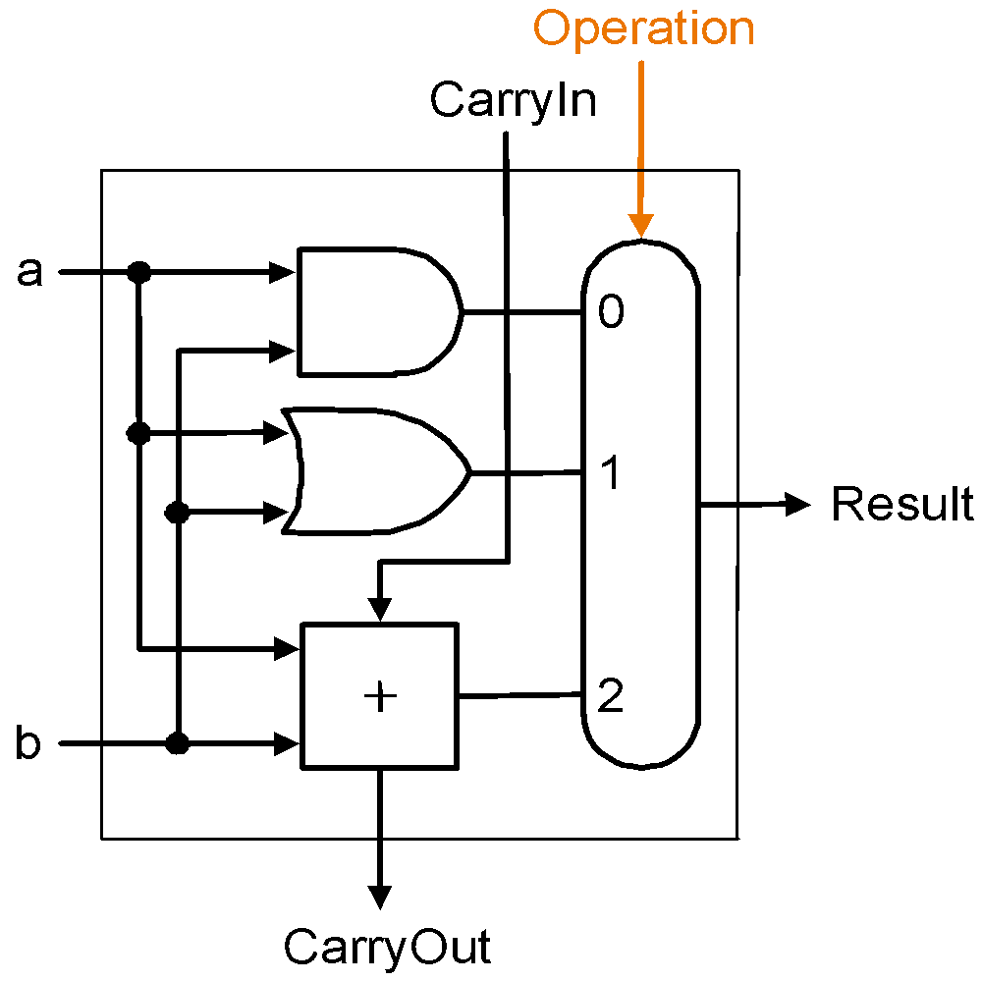
Building a 32-bit ALU
Multiplexor control line
1-bit ALU for AND, OR and add
Ripple-Carry Logic for 32-bit ALU
Notes:
‹#›

Slide 17
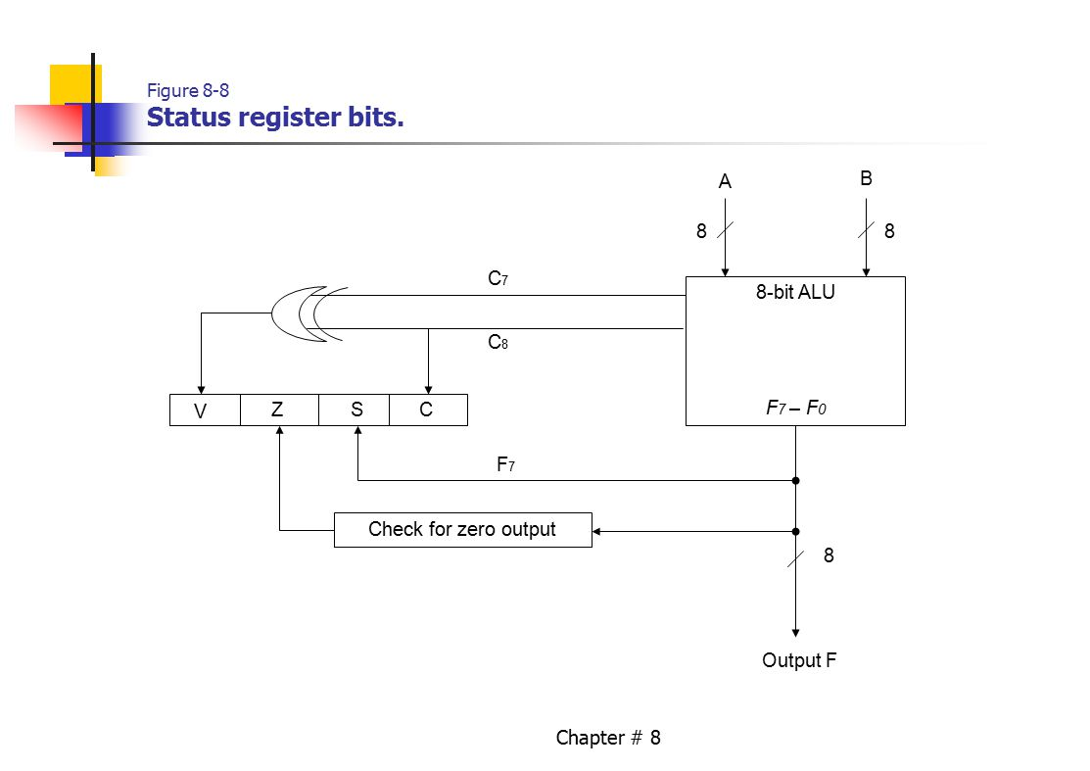
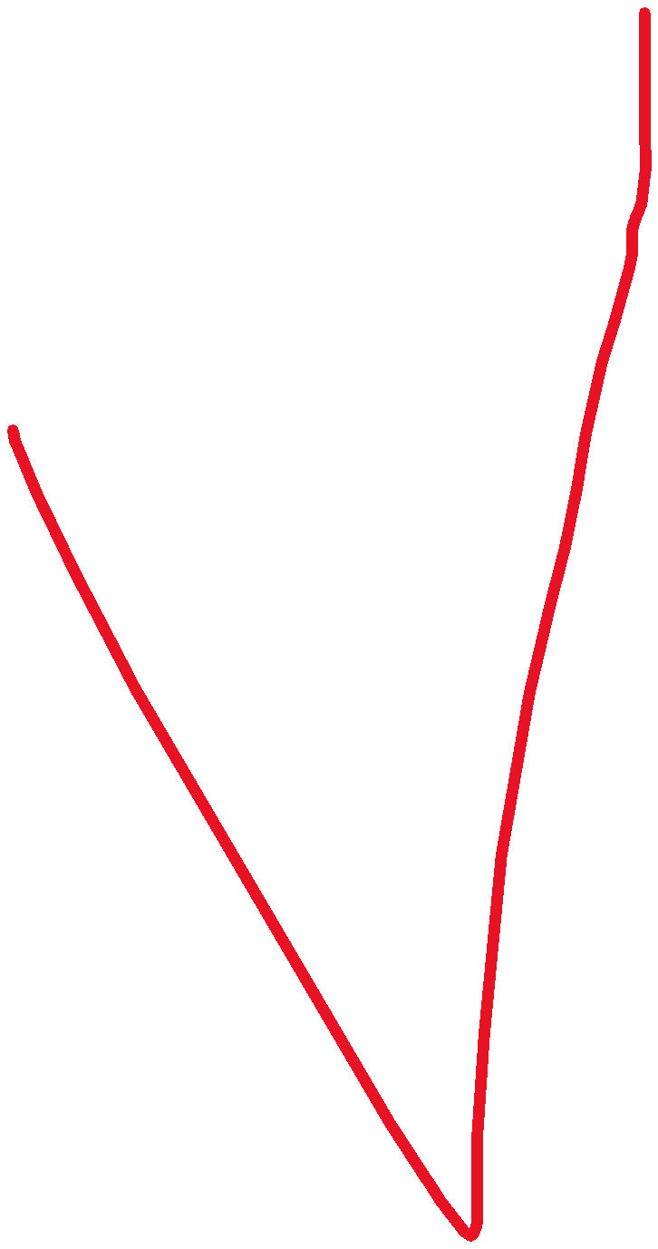
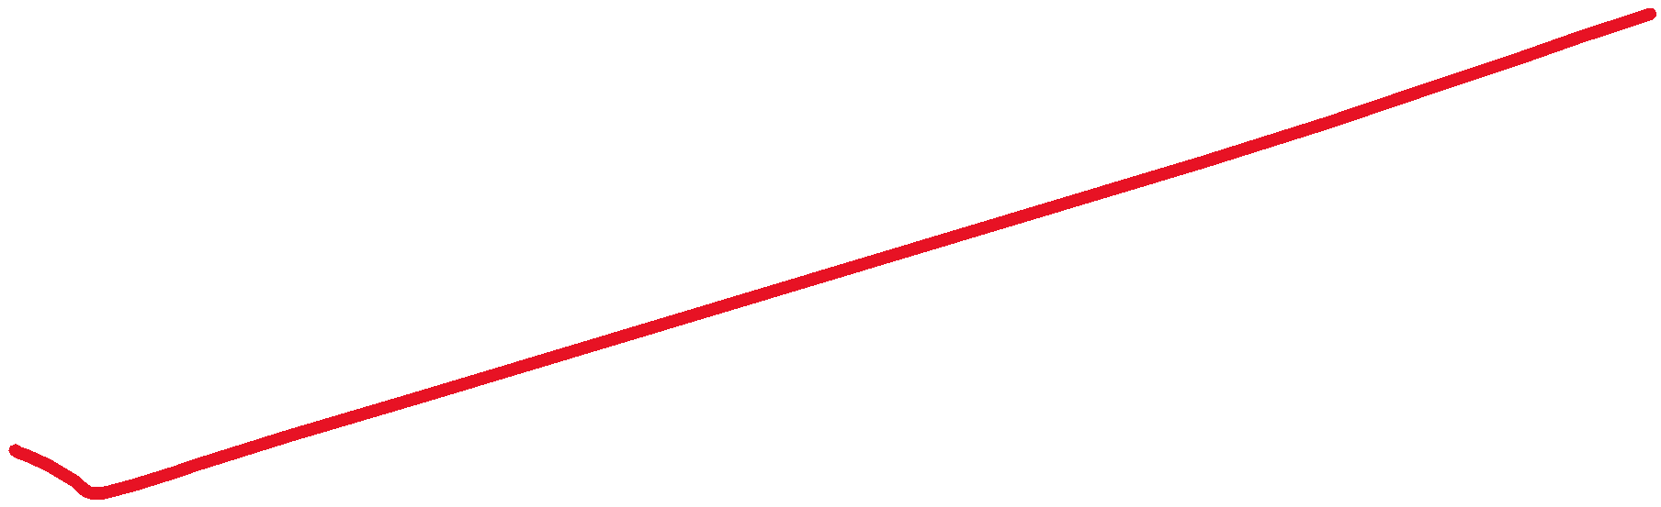









Status Register

Slide 18

Multiply
Grade school shift-add method:
Multiplicand 1000
Multiplier 1001 1000 0000 0000 1000 Product 01001000
m bits x n bits = m+n bit product
Binary makes it easy:
multiplier bit 1 => copy multiplicand (1 x multiplicand)
multiplier bit 0 => place 0 (0 x multiplicand)
3 versions of multiply hardware & algorithm:
x
Notes:
‹#›

Slide 19
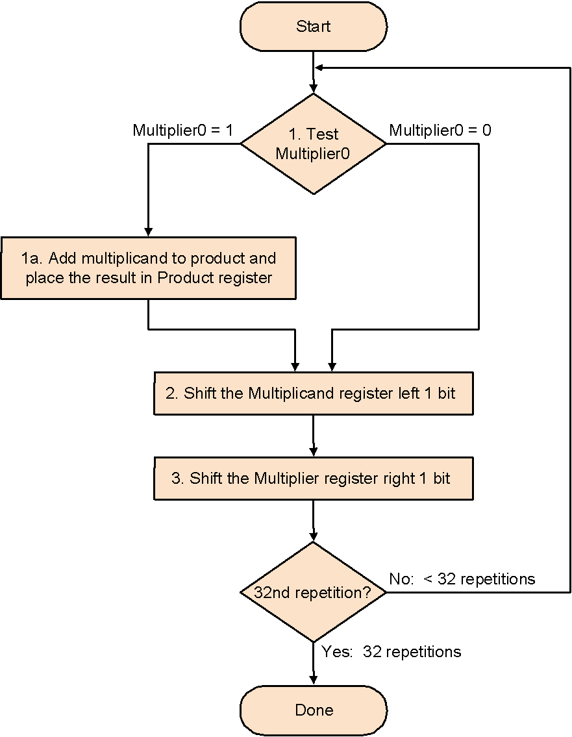
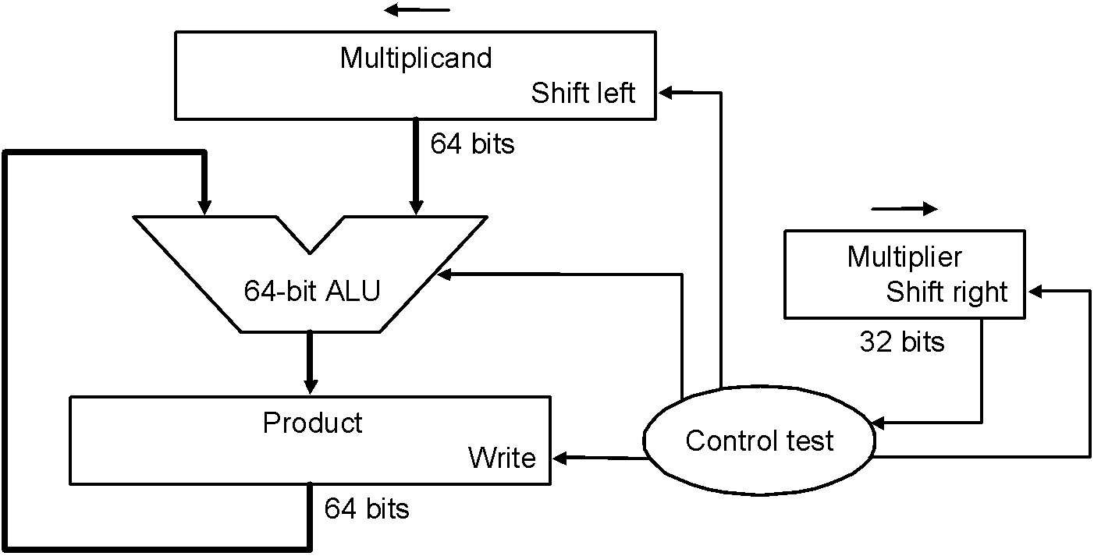
Shift-add Multiplier Version 1
32-bit multiplicand starts at right half of multiplicand register
Product register is initialized at 0
Multiplicand register, product register, ALU are
64-bit wide; multiplier register is 32-bit wide
Algorithm
Notes:
‹#›

Slide 20
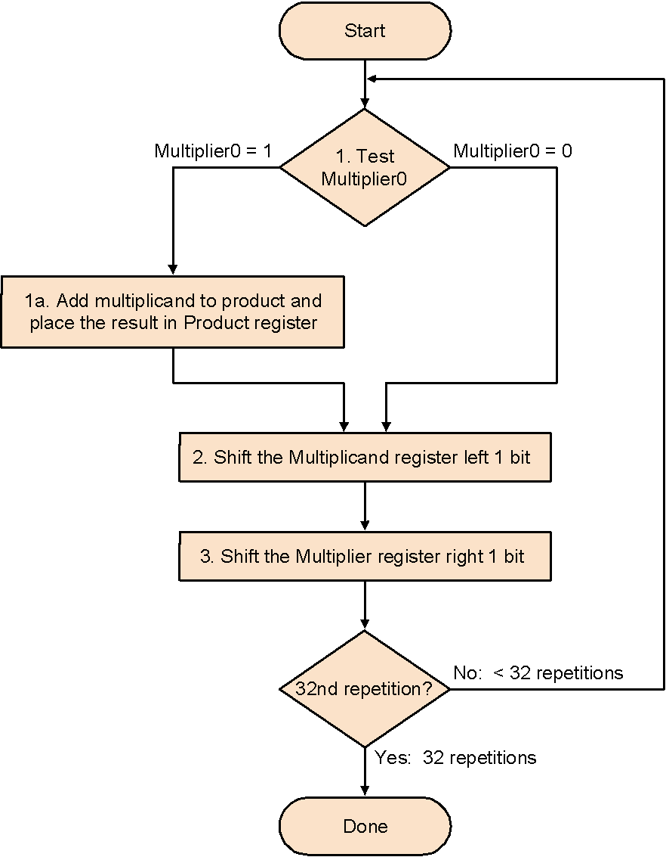



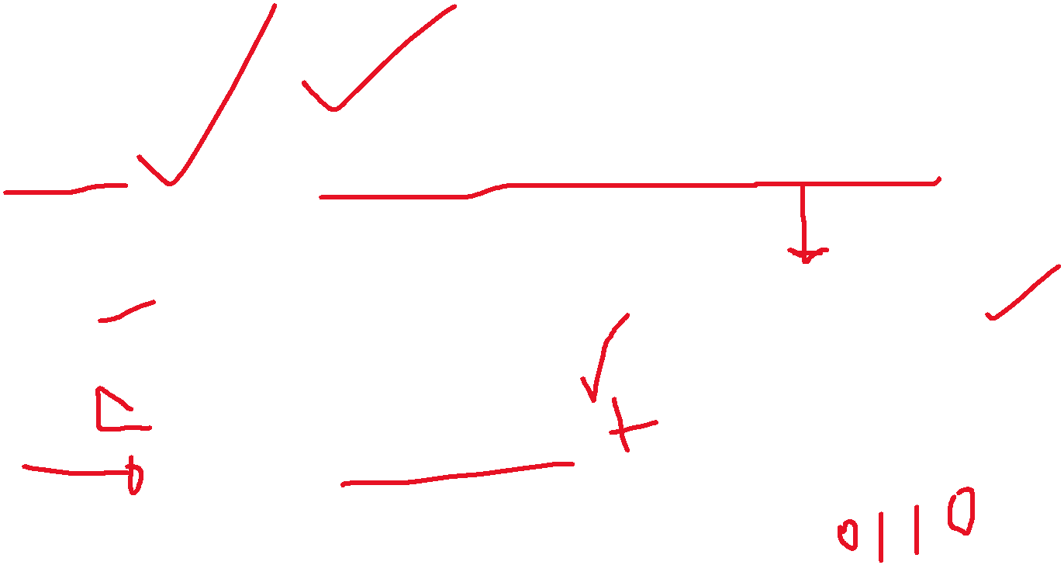



Shift-add Multiplier Version1
Example: 0010 * 0011:
Itera Step Multiplier Multiplicand Product
-tion
0 init 0011 0000 0010 0000 0000
values
1 1a 0011 0000 0010 0000 0010
2 0011 0000 0100 0000 0010
3 0001 0000 0100 0000 0010
2 …
Algorithm
Notes:
‹#›
M’ier: 0011 M’and: 0000 0010 P: 0000 0000
1a. 1=>P=P+Mcand M’ier: 0011 Mcand: 0000 0010 P: 0000 0010
2. Shl Mcand M’ier: 0011 Mcand: 0000 0100 P: 0000 0010
3. Shr M’ier M’ier: 0001 Mcand: 0000 0100 P: 0000 0010
1a. 1=>P=P+Mcand M’ier: 0001 Mcand: 0000 0100 P: 0000 0110
2. Shl Mcand M’ier: 0001 Mcand: 0000 1000 P: 0000 0110
3. Shr M’ier M’ier: 0000 Mcand: 0000 1000 P: 0000 0110
1. 0=>nop M’ier: 0000 Mcand: 0000 1000 P: 0000 0110
2. Shl Mcand M’ier: 0000 Mcand: 0001 0000 P: 0000 0110
3. Shr M’ier M’ier: 0000 Mcand: 0001 0000 P: 0000 0110
1. 0=>nop M’ier: 0000 Mcand: 0001 0000 P: 0000 0110
2. Shl Mcand M’ier: 0000 Mcand: 0010 0000 P: 0000 0110
3. Shr M’ier M’ier: 0000 Mcand: 0010 0000 P: 0000 0110

Slide 21
Observations on Multiply Version 1
1 step per clock cycle ⇒ nearly 100 clock cycles to multiply two
32-bit numbers
Half the bits in the multiplicand register always 0
⇒ 64-bit adder is wasted
0’s inserted to right as multiplicand is shifted left ⇒ least significant bits of product never change once formed
Intuition: instead of shifting multiplicand to left, shift product to right…
Notes:
‹#›

Slide 22
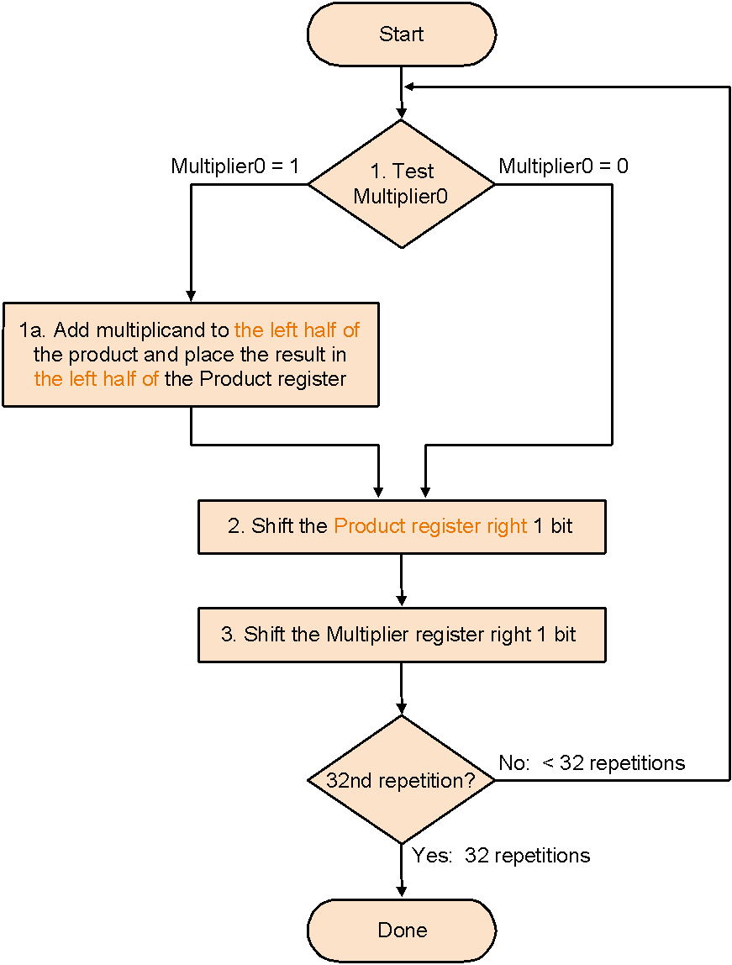
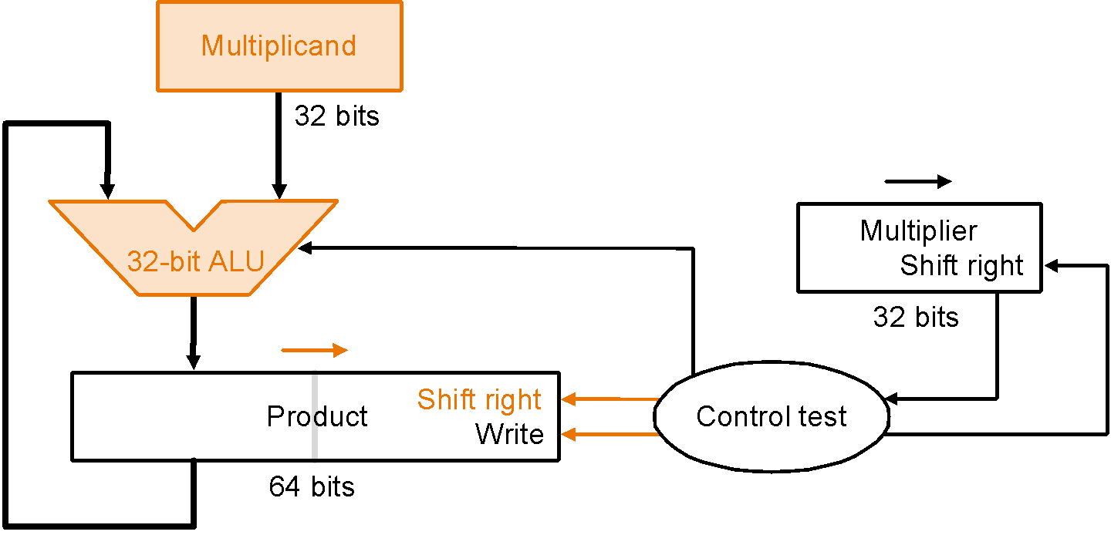
Shift-add Multiplier Version 2
Product register is initialized at 0
Multiplicand register, multiplier register, ALU
are 32-bit wide; product register is 64-bit wide;
multiplicand adds to left half of product register
Algorithm
Notes:
‹#›

Slide 23
Shift-add Multiplier Version 2
Example: 0010 * 0011:
Itera Step Multiplier Multiplicand Product
-tion
0 init 0011 0010 0000 0000
values
1 1a 0011 0010 0010 0000
2 0011 0010 0001 0000
3 0001 0010 0001 0000
2 …
Algorithm
Notes:
‹#›
M’ier: 0011 Mcand: 0010 P: 0000 0000
1a. 1=>P=P+Mcand M’ier: 0011 Mcand: 0010 P: 0010 0000
2. Shr P M’ier: 0011 Mcand: 0010 P: 0001 0000
3. Shr M’ier M’ier: 0001 Mcand: 0010 P: 0001 0000
1a. 1=>P=P+Mcand M’ier: 0001 Mcand: 0010 P: 0011 0000
2. Shr P M’ier: 0001 Mcand: 0010 P: 0001 1000
3. Shr M’ier M’ier: 0000 Mcand: 0010 P: 0001 1000
1. 0=>nop M’ier: 0000 Mcand: 0010 P: 0001 1000
2. Shr P M’ier: 0000 Mcand: 0010 P: 0000 1100
3. Shr M’ier M’ier: 0000 Mcand: 0010 P: 0000 1100
1. 0=>nop M’ier: 0000 Mcand: 0010 P: 0000 1100
2. Shr P M’ier: 0000 Mcand: 0010 P: 0000 0110
3. Shr M’ier M’ier: 0000 Mcand: 0010 P: 0000 0110

Slide 24
Observations on Multiply Version 2
Each step the product register wastes space that exactly matches the current size of the multiplier
Intuition: combine multiplier register and product register…
Notes:
‹#›

Slide 25
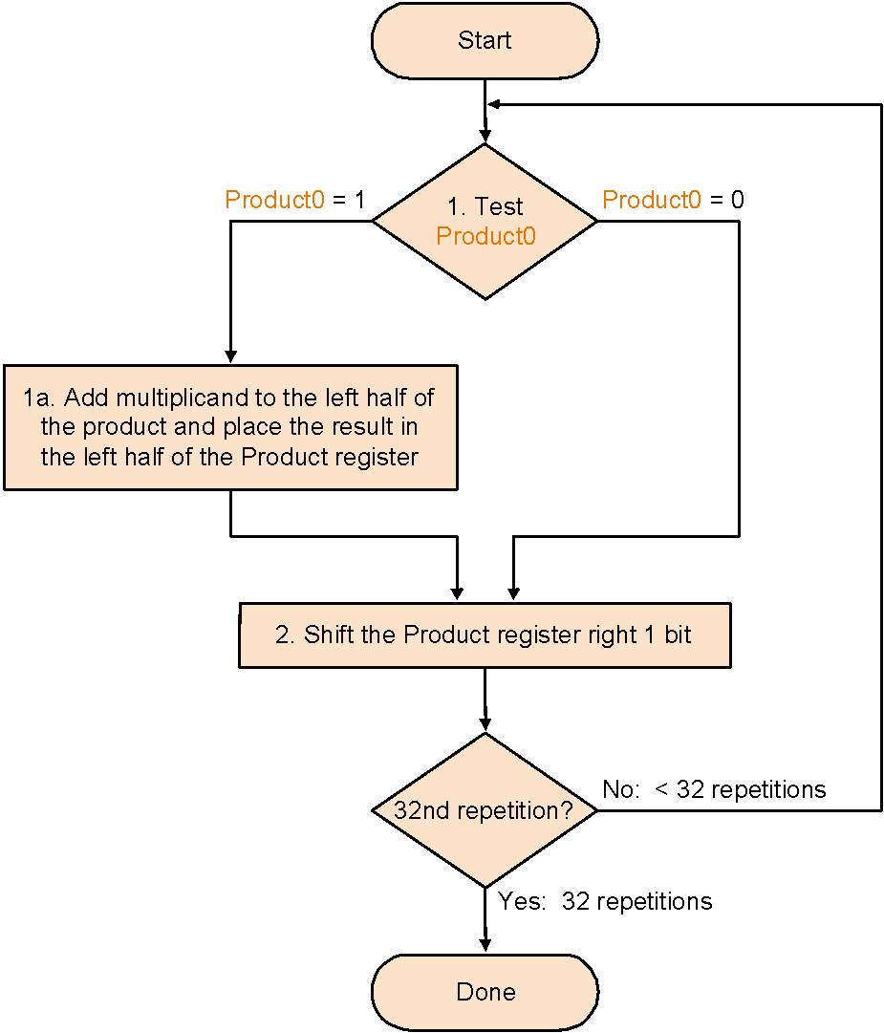
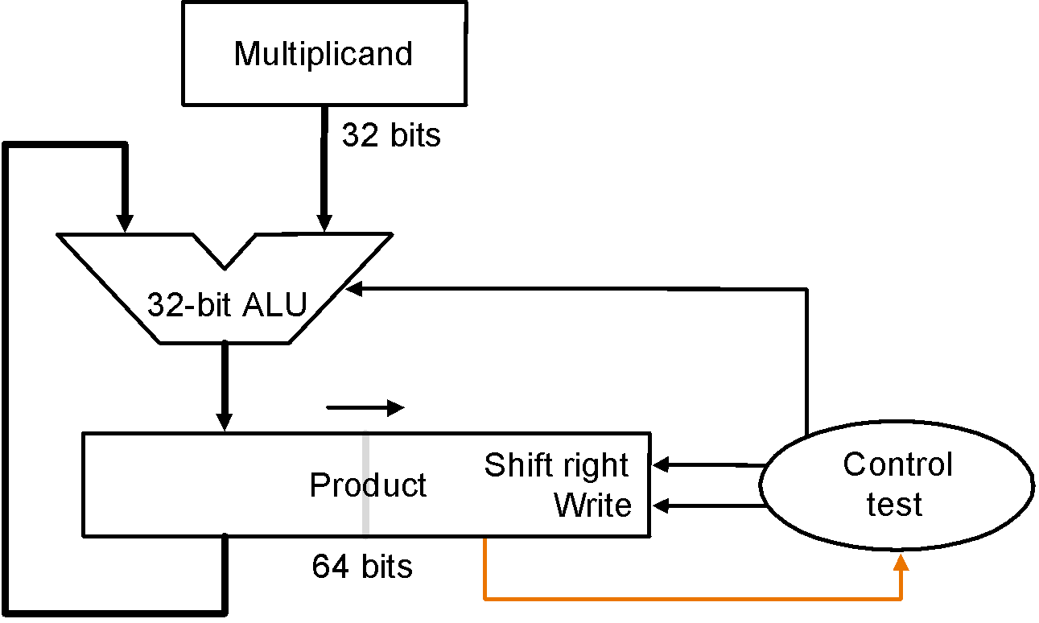
Shift-add Multiplier Version 3
Product register is initialized with multiplier on right
No separate multiplier register; multiplier
placed on right side of 64-bit product register
Algorithm
Notes:
‹#›

Slide 26
Shift-add Multiplier Version 3
Example: 0010 * 0011:
Itera Step Multiplicand Product
-tion
0 init 0010 0000 0011
values
1 1a 0010 0010 0011
2 0010 0001 0001
2 …
Algorithm
Notes:
‹#›

Slide 27
Observations on Multiply Version 3
2 steps per bit because multiplier & product combined
What about signed multiplication?
easiest solution is to make both positive and remember whether to negate product when done, i.e., leave out the sign bit, run for 31 steps, then negate if multiplier and multiplicand have opposite signs
Booth’s Algorithm is an elegant way to multiply signed numbers using same hardware – it also often quicker…
Notes:
‹#›

Slide 28
Motivating Booth’s algorithm
Example 0010 * 0110. Traditional:
0010
0110
0000 shift (0 in multiplier)
0010 add (1 in multiplier)
0010 add (1 in multiplier)
0000 shift (0 in multiplier)
00001100
Same example. But observe there are two successive 1’s in multiplier
0110 = 2² + 2¹ = 2³ – 2¹, so can replace successive 1’s by subtract and then add:
0010
0110
0000 shift (0 in multiplier)
-0010 sub (first 1 in multiplier)
0000 shift (middle of string of 1’s)
0010 add (previous step had last 1)
00001100
x
Notes:
‹#›

Slide 29

Motivating Booth’s Algorithm
Math idea: string of 1’s …011…10… has
value the sum 2^{n} + 2^{n-1} + … + 2^{m} = 2^{n+1} – 2^{m}
Replace a string of 1s in multiplier with an initial subtract when we first see a one and then later add after the last one
What if the string of 1’s started from the left of the (2’s complement) number,
e.g., 11110001 – would the formula above have to be modified?!
bit = 2^{n}
bit = 2^{m}
successive 1’s
Notes:
‹#›

Slide 30
Booth from Multiply Version 3
Modify Step 1 of the algorithm Multiply Version 3 to consider 2 bits of the multiplier: the current bit and the bit to the right (i.e., the current bit of the previous step). Instead of two outcomes, now there are four:
Case Current Bit Bit to the Right Explanation Example Op
1a 0 0 Middle of run of 0s 0001111000 none
1b 0 1 End of run of 1s 0001111000 add
1c 1 0 Begins run of 1s 0001111000 sub
1d 1 1 Middle of run of 1s 0001111000 none
Modify Step 2 of Multiply Version 3 to sign extend when the product is shifted right (arithmetic right shift, rather than logical right shift) because the product is a signed number
Now draw the flowchart for Booth’s algorithm !
Multiply Version 3 and Booth share the same hardware, except Booth requires one extra flipflop to remember the bit to the right of the current bit in the product register – which is the bit pushed out by the preceding right shift

Slide 31
Booth Example (2 x 7)
Operation Multiplicand Product next?
0. initial value 0010 0000 0111 0 10 -> sub P = P - M
1c. 0010 1110 0111 0 shift P (sign ext)
2. 0010 1111 0011 1 11 -> nop
1d. 0010 1111 0011 1 shift P (sign ext)
2. 0010 1111 1001 1 11 -> nop
1d. 0010 1111 1001 1 shift P (sign ext)
2. 0010 1111 1100 1 01 -> add P = P + M
1b. 0010 0001 1100 1 shift P (sign ext)
2. 0010 0000 1110 0 done

Slide 32
Booth Algorithm (2 * -3)
Operation Multiplicand Product next?
0.initial value 0010 0000 1101 0 10 -> sub P = P - M
1c. 0010 1110 1101 0 shift P (sign ext)
2. 0010 1111 0110 1 01 -> add P = P + M
1b. 0010 0001 0110 1 shift P (sign ext)
2. 0010 0000 1011 0 10 -> sub P = P - M
1c. 0010 1110 1011 0 shift P
2. 0010 1111 0101 1 11 -> nop
1d. 0010 1111 0101 1 shift P
2. 0010 1111 1010 1 done

Slide 33
Verifying Booth’s Algorithm
multiplier a = a₃₁ a₃₂… a₀, multiplicand = b
a_{i} a_{i-1} Operation
0 0 nop
0 1 add b
1 0 sub b
1 1 nop
0, nop
I.e., if a_{i-1} – a_{i} = +1, add b
–1, sub b
Therefore, Booth computes sum:
(a_{–1} – a₀) * b * 2⁰
+ (a₀ – a ₁) * b * 2¹
+ (a₁ – a₂) * b * 2²
…
+ (a₃₀ – a₃₁) * b * 2³¹
= … simplify telescopic sum! …

Slide 34
MIPS Notes
MIPS provides two 32-bit registers Hi and Lo to hold a 64-bit product
mult, multu (unsigned) put the product of two 32-bit register operands into Hi and Lo: overflow is ignored by MIPS but can be detected by programmer by examining contents of Hi
mflo, mfhi moves content of Hi or Lo to a general-purpose register
Pseudo-instructions mul (without overflow), mulo (with overflow), mulou (unsigned with overflow) take three 32-bit register operands, putting the product of two registers into the third

Slide 35
Divide
1001 Quotient
Divisor 1000 1001010 Dividend –1000 10 101 1010 –1000 10 Remainder
Junior school method: see how big a multiple of the divisor can be subtracted, creating quotient digit at each step
Binary makes it easy ⇒ first, try 1 * divisor; if too big, 0 * divisor
Dividend = (Quotient * Divisor) + Remainder
3 versions of divide hardware & algorithm:
Notes:
‹#›

Slide 36
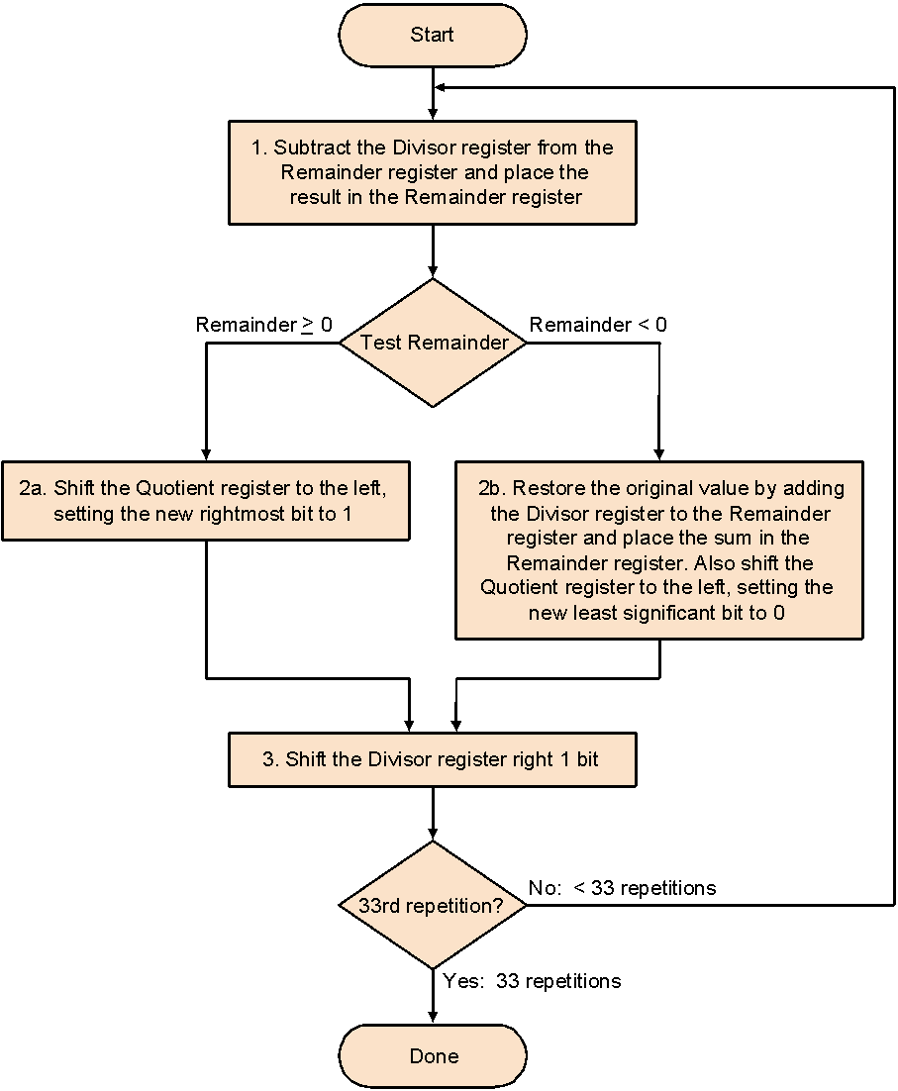
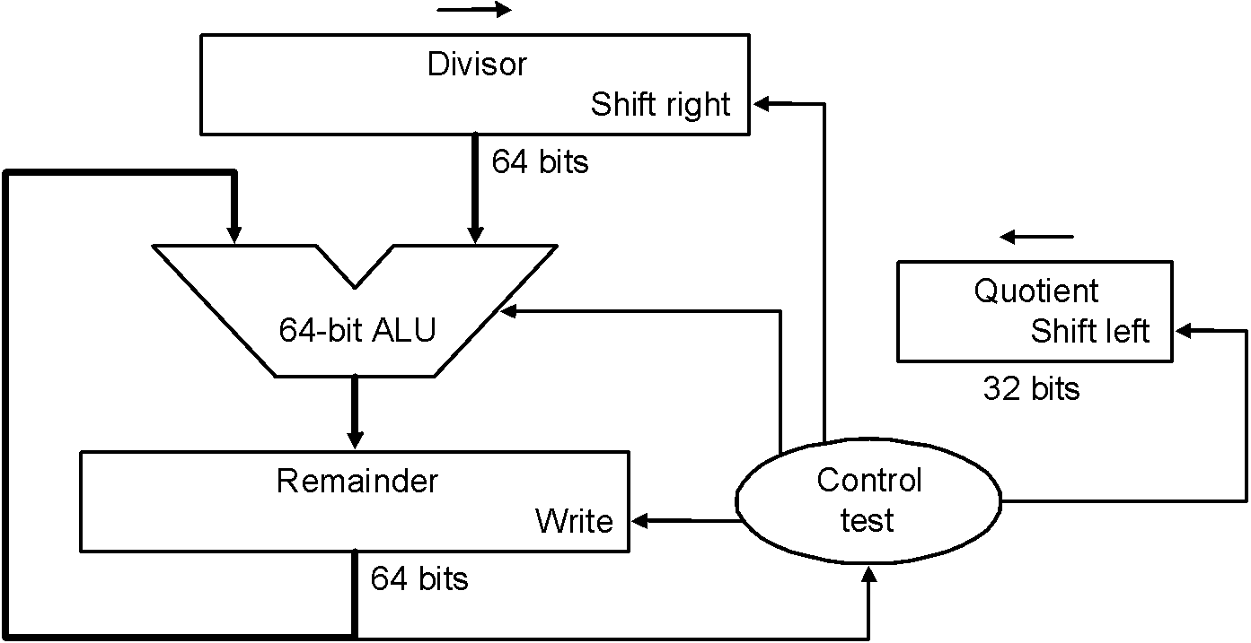
Divide Version 1
32-bit divisor starts at left half of divisor register
Quotient register is
initialized to be 0
Remainder register is initialized with the dividend at right
Divisor register, remainder register, ALU are
64-bit wide; quotient register is 32-bit wide
Why 33? We shall see later…
Algorithm
Notes:
‹#›

Slide 37
Divide Version 1
Example: 0111 / 0010:
Itera- Step Quotient Divisor Remainder
tion
0 init 0000 0010 0000 0000 0111
1 1 0000 0010 0000 1110 0111
2b 0000 0010 0000 0000 0111
3 0000 0001 0000 0000 0111
2 …
3
4
5
Algorithm

Slide 38
Observations on Divide Version 1
Half the bits in divisor always 0
⇒ 1/2 of 64-bit adder is wasted
⇒ 1/2 of divisor register is wasted
Intuition: instead of shifting divisor to right, shift remainder to left…
Step 1 cannot produce a 1 in quotient bit – as all bits corresponding to the divisor in the remainder register are 0 (remember all operands are 32-bit)
Intuition: switch order to shift first and then subtract – can save 1 iteration…
Notes:
‹#›

Slide 39
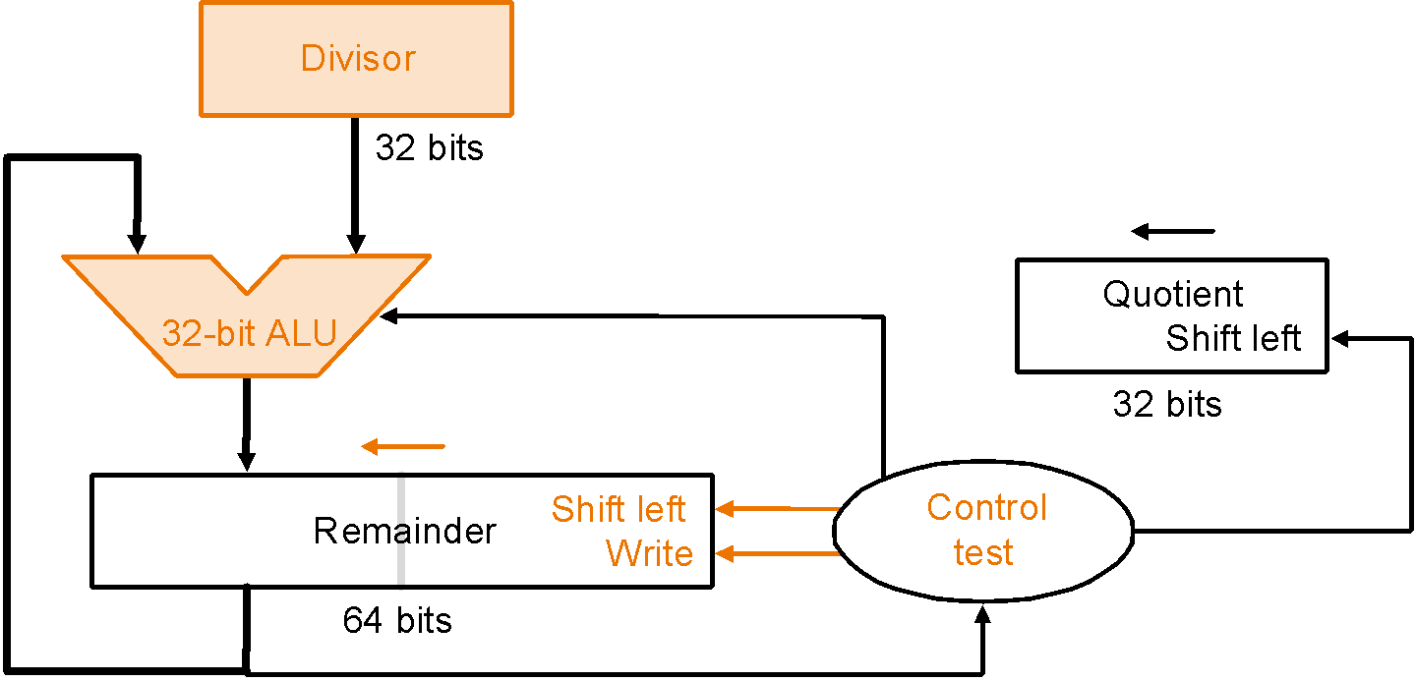
Divide Version 2
S
t
a
r
t
1
.
S
h
i
f
t
t
h
e
R
e
m
a
i
n
d
e
r
r
e
g
i
s
t
e
r
l
e
f
t
1
b
i
t
Remainder register is initialized
with the dividend at right
2
.
S
u
b
t
r
a
c
t
t
h
e
D
i
v
i
s
o
r
r
e
g
i
s
t
e
r
f
r
o
m
t
h
e
l
e
f
t
h
a
l
f
o
f
t
h
e
R
e
m
a
i
n
d
e
r
r
e
g
i
s
t
e
r
a
n
d
p
l
a
c
e
t
h
e
r
e
s
u
l
t
i
n
t
h
e
l
e
f
t
h
a
l
f
o
f
t
h
e
R
e
m
a
i
n
d
e
r
r
e
g
i
s
t
e
r
R
e
m
a
i
n
d
e
r
>
0
R
e
m
a
i
n
d
e
r
<
0
–
T
e
s
t
R
e
m
a
i
n
d
e
r
3
a
.
S
h
i
f
t
t
h
e
R
e
m
a
i
n
d
e
r
r
e
g
i
s
t
e
r
t
o
t
h
e
3
b
.
R
e
s
t
o
r
e
t
h
e
o
r
i
g
i
n
a
l
v
a
l
u
e
b
y
a
d
d
i
n
g
l
e
f
t, setting the new rightmost bit to 0.
t
h
e
D
i
v
i
s
o
r
r
e
g
i
s
t
e
r
t
o
t
h
e
l
e
f
t
h
a
l
f
o
f
t
h
e
Also shift the Quotient register to the left
setting to the new rightmost bit to 1.
R
e
m
a
i
n
d
e
r
r
e
g
i
s
t
e
r
a
n
d
p
l
a
c
e
t
h
e
s
u
m
Divisor register, quotient register,
ALU are 32-bit wide; remainder
register is 64-bit wide
i
n
t
h
e
l
e
f
t
h
a
l
f
o
f
t
h
e
R
e
m
a
i
n
d
e
r
r
e
g
i
s
t
e
r
.
A
l
s
o
s
h
i
f
t
t
h
e
R
e
m
a
i
n
d
e
r
r
e
g
i
s
t
e
r
t
o
t
h
e
l
e
f
t
,
s
e
t
t
i
n
g
t
h
e
n
e
w
r
i
g
h
t
m
o
s
t
b
i
t
t
o
0
Also shift the Quotient register to the left
setting to the new rightmost bit to 0.
3
2
n
d
r
e
p
e
t
i
t
i
o
n
?
N
o
:
<
3
2
r
e
p
e
t
i
t
i
o
n
s
Y
e
s
:
3
2
r
e
p
e
t
i
t
i
o
n
s
Algorithm
Why this correction step? We shall see later…
D
o
n
e
.
S
h
i
f
t
l
e
f
t
h
a
l
f
o
f
R
e
m
a
i
n
d
e
r
r
i
g
h
t
1
b
i
t
Notes:
‹#›
Q: 0000 D: 0010 0000 R: 0000 0111 –D = 1110 0000
1: R = R–D Q: 0000 D: 0010 0000 R: 1110 0111
2b: +D, sl Q, 0 Q: 0000 D: 0010 0000 R: 0000 0111
3: Shr D Q: 0000 D: 0001 0000 R: 0000 0111 –D = 1111 0000
1: R = R–D Q: 0000 D: 0001 0000 R: 1111 0111
2b: +D, sl Q, 0 Q: 0000 D: 0001 0000 R: 0000 0111
3: Shr D Q: 0000 D: 0000 1000 R: 0000 0111 –D = 1111 1000
1: R = R–D Q: 0000 D: 0000 1000 R: 1111 1111
2b: +D, sl Q, 0 Q: 0000 D: 0000 1000 R: 0000 0111
3: Shr D Q: 0000 D: 0000 0100 R: 0000 0111 –D = 1111 1100
1: R = R–D Q: 0000 D: 0000 0100 R: 0000 0011
2a: sl Q, 1 Q: 0001 D: 0000 0100 R: 0000 0011
3: Shr D Q: 0000 D: 0000 0010 R: 0000 0011 –D = 1111 1110
1: R = R–D Q: 0000 D: 0000 0010 R: 0000 0001
2a: sl Q, 1 Q: 0011 D: 0000 0010 R: 0000 0001
3: Shr D Q: 0011 D: 0000 0001 R: 0000 0001
Recommend show 2’s comp of divisor, show lines for subtract divisor and restore remainder

Slide 40
Observations on Divide Version 2
Each step the remainder register wastes space that exactly matches the current size of the quotient
Intuition: combine quotient register and remainder register…
Notes:
‹#›

Slide 41
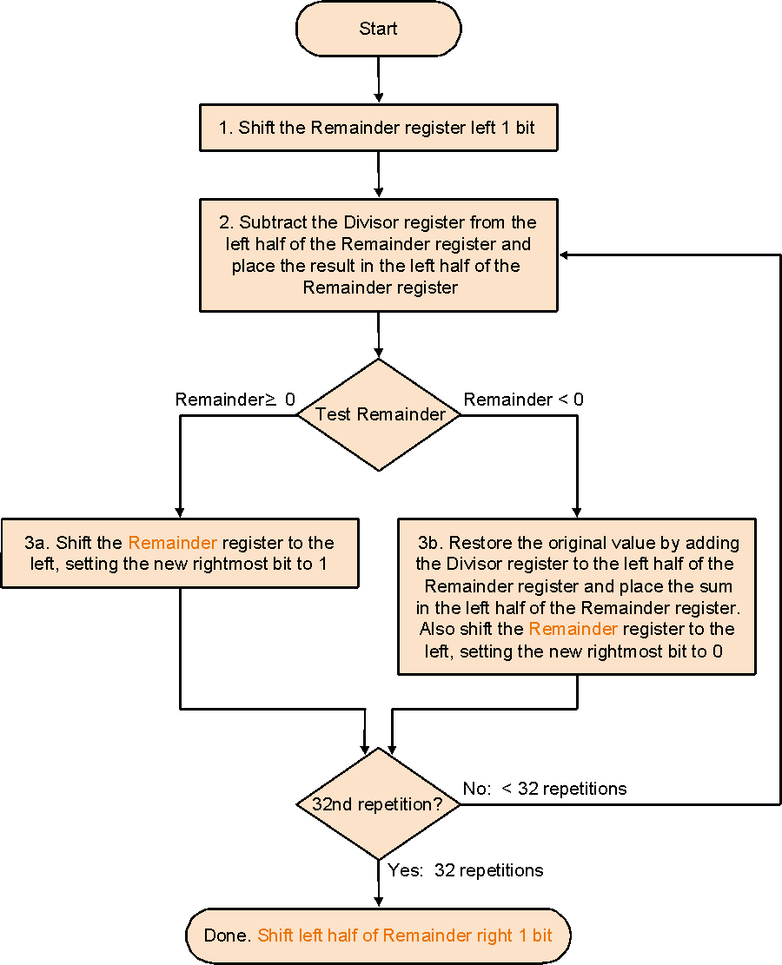
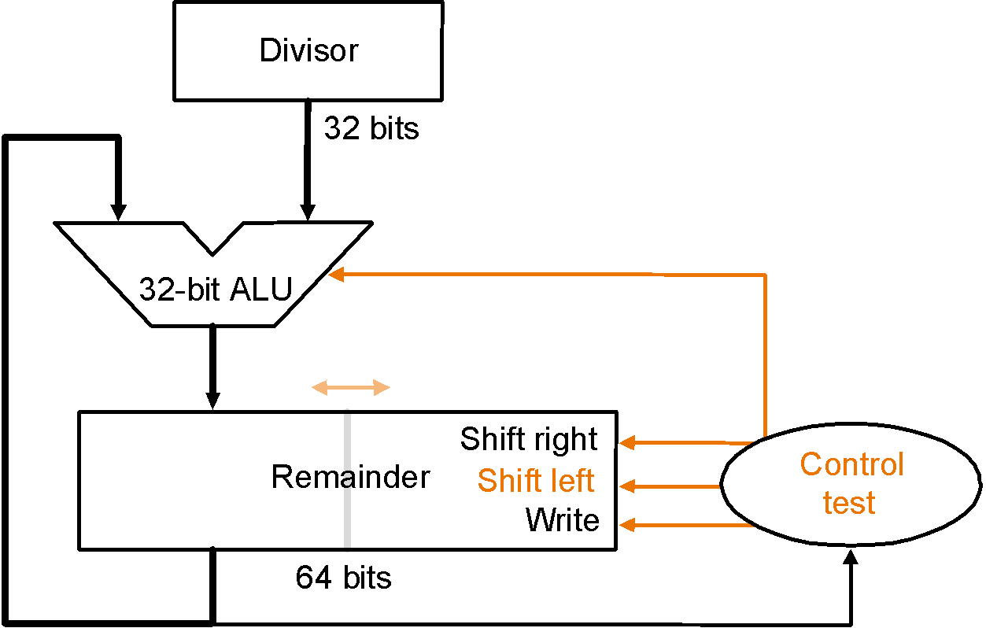
Divide Version 3
Remainder register is initialized with the dividend at right
No separate quotient register; quotient
is entered on the right side of the 64-bit
remainder register
Algorithm
Why this correction step? We shall see later…
Notes:
‹#›

Slide 42
Divide Version 3
Example: 0111 / 0010:
Itera- Step Divisor Remainder
tion
0 init 0010 0000 0111
1 0010 0000 1110
1 2 0010 1110 1110
3b 0010 0001 1100
2 …
3
4
Algorithm

Slide 43
Number of Iterations
Why the extra iteration in Version 1?
Why the final correction step in Versions 2 & 3?
shift1 shift2 … shift32 shift33
sub1 sub2 sub3 … sub32 sub33
Ovals represent loop iterations
Main insight – sub(i+1) must actually follow shifti of
the divisor (or remainder, depending on version) and
the resulting bit in the quotient appears on shift(i+1)
Shift: see the version descriptions
for which registers are shifted
V1 starts loop
here: unnecessary
sub step
One loop iteration
Critical situation! Only the quotient shift is
necessary as it corresponds to the
outcome of the previous sub.
So V1 is ok even though the last divisor
shift is redundant, as final divisor is ignored
any way; V2 & 3 must repair remainder
as it has shifted left one time too many
V2 & 3 start
loop here
V2 & 3 initial step:
before loop starts
Notes:
‹#›

Slide 44
Observations on Divide Version 3
Same hardware as Multiply Version 3
Signed divide:
make both divisor and dividend positive and perform division
negate the quotient if divisor and dividend were of opposite signs
make the sign of the remainder match that of the dividend
this ensures always
dividend = (quotient * divisor) + remainder
–quotient (x/y) = quotient (–x/y) (e.g. 7 = 3*2 + 1 & –7 = –3*2 – 1)

